Slide 1
Unit -4

Slide 2
Unit 4 outline
Segmentation by Fitting a Model:
The Hough Transform, Fitting Lines, Fitting Curves, Fitting as a Probabilistic Inference Problem, Robustness,
Segmentation and Fitting Using Probabilistic Methods:Missing Data Problems, Fitting, and Segmentation, The EM Algorithm in Practice,
Tracking With Linear Dynamic Models:
Tracking as an Abstract Inference Problem
Linear Dynamic Models,
Kalman Filtering, Data Association
Applications and Examples.

Slide 3
Segmentation by Fitting a Model:
An alternative view of segmentation is to assert that pixels (tokens, etc.) belong together, because together they conform to some model.
This view is rather similar to the clustering view; the main difference is that the model is now explicit, and may involve relations at a larger scale than from token to token.

Slide 4
For example, imagine a program that attempts to assemble tokens into groups that “look like” a line (in some sense we don’t need to make precise at this point). It isn’t possible to do this by looking only at pairwise relations between tokens — instead, we must look at some properties of the collective of tokens
fitting involves choosing a model, and then declaring some criterion by which a good fit can be identified

Slide 5
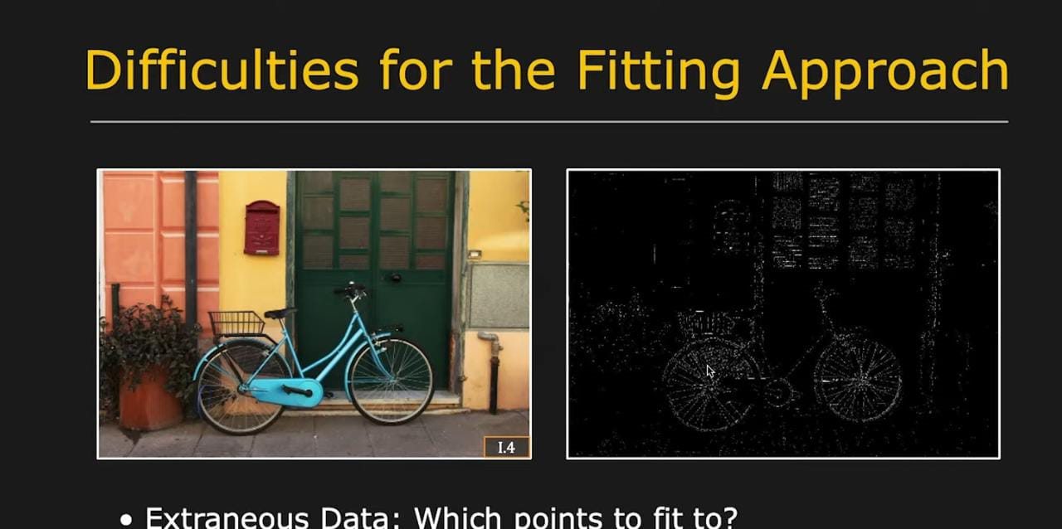

Slide 6
The Hough Transform
One way to cluster points that could lie on the same structure is to record all the structures on which each point lies, and then look for structures that get many votes. This (quite general) technique is known as the Hough transform.
We take each image token, and determine all structures that could pass through that token.

Slide 7
We make a record of this set — you should think of this as voting — and repeat the process for each token. We decide on what is present by looking at the votes.
For example, if we are grouping points that lie on lines, we take each point and vote for all lines that could go through it; we now do this for each point. The line (or lines) that are present should make themselves obvious, because they pass through many points and so have many votes

Slide 8
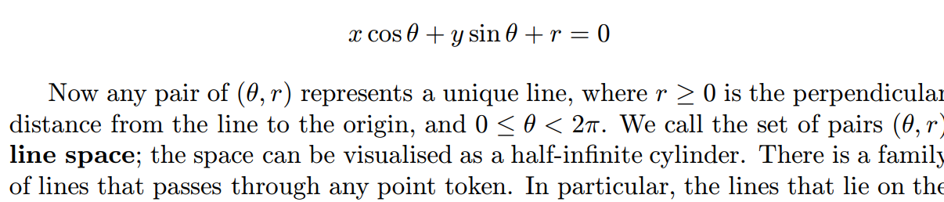
Fitting Lines with the Hough Transform
Hough transforms tend to be most successfully applied to line finding. We will do this example to illustrate the method and its drawbacks. A line is easily parametrised as a collection of points (x, y) such that

Slide 9
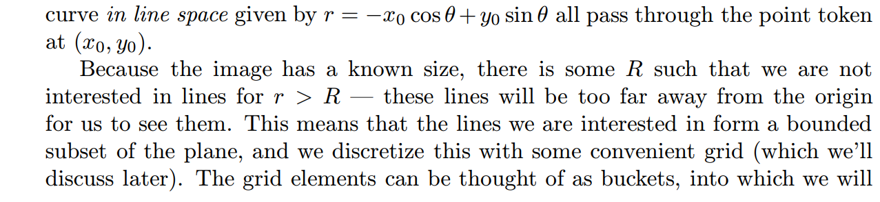

Slide 10
sort votes. This grid of buckets is referred to as the accumulator array. Now for each point token we add a vote to the total formed for every grid element on the curve corresponding to the point token.
If there are many point tokens that are collinear, we expect that there will be many votes in the grid element corresponding to that line

Slide 11
Practical Problems with the Hough Transform
Quantization errors: an appropriate grid size is difficult to pick. Too coarse a grid can lead to large values of the vote being obtained falsely, because many quite different lines correspond to a bucket. Too fine a value of the grid can lead to lines not being found, because votes resulting from tokens that are not exactly collinear end up in different buckets, and no bucket has a large vote

Slide 12
Difficulties with noise: the attraction of the Hough transform is that it connects widely separated tokens that lie “close” to some form of parametric curve. This is also a weakness; it is usually possible to find many quite good phantom lines in a large set of reasonably uniformly distributed tokens. This means that, for example, regions of texture can generate peaks in the voting array that are larger than those associated with the lines sought

Slide 13
The Hough transform is worth talking about, because, despite these difficulties, it can often be implemented in a way that is quite useful for well-adapted problems. In practice, it is almost always used to find lines in sets of edge points. Useful implementation guidelines are:
Ensure the minimum of irrelevant tokens this can often be done by tuning the edge detector to smooth out texture, setting the illumination to produce high contrast edges, etc.

Slide 14
Choose the grid carefully this is usually done by trial and error. It can be helpful to vote for all neighbours of a grid element at the same time one votes for the element.

Slide 15
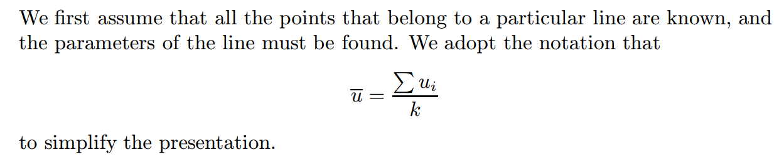
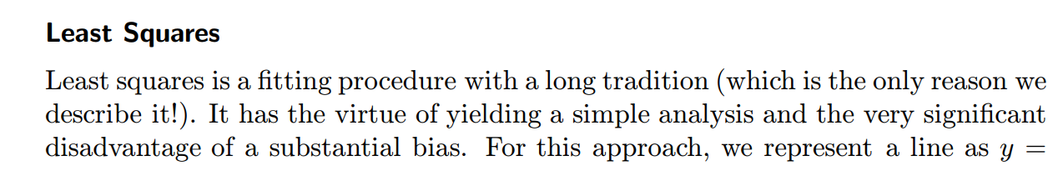
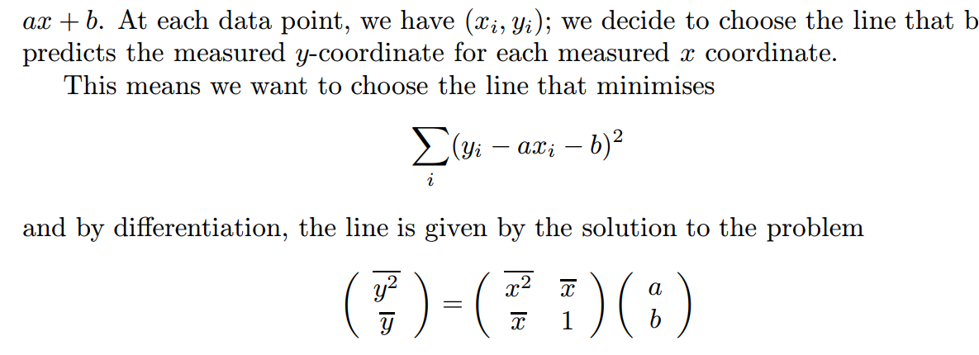
Line Fitting with Least Squares

Slide 16
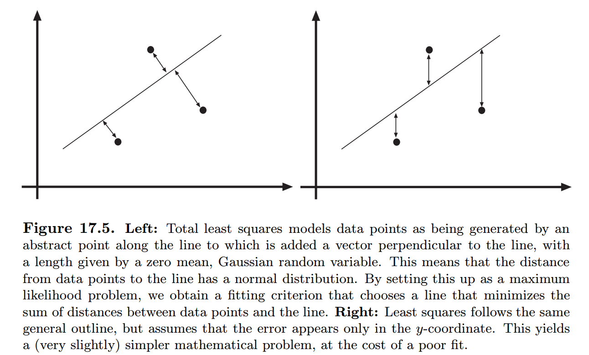

Slide 17
Total Least Squares We could work with the actual distance between the point and the line (rather than the vertical distance). This leads to a problem known as total least squares. We can represent a line as the collection of points where ax+by +c = 0.

Slide 18
Which Point is on Which Line?
Incremental Fitting:
Incremental line fitting algorithms take connected curves of edge points and fit lines to runs of points along the curve. Connected curves of edge points are fairly easily obtained from an edge detector whose output gives orientation (see exercises). An incremental fitter then starts at one end of a curve of edge points and walks along the curve, cutting off runs of pixels that fit a line well

Slide 19
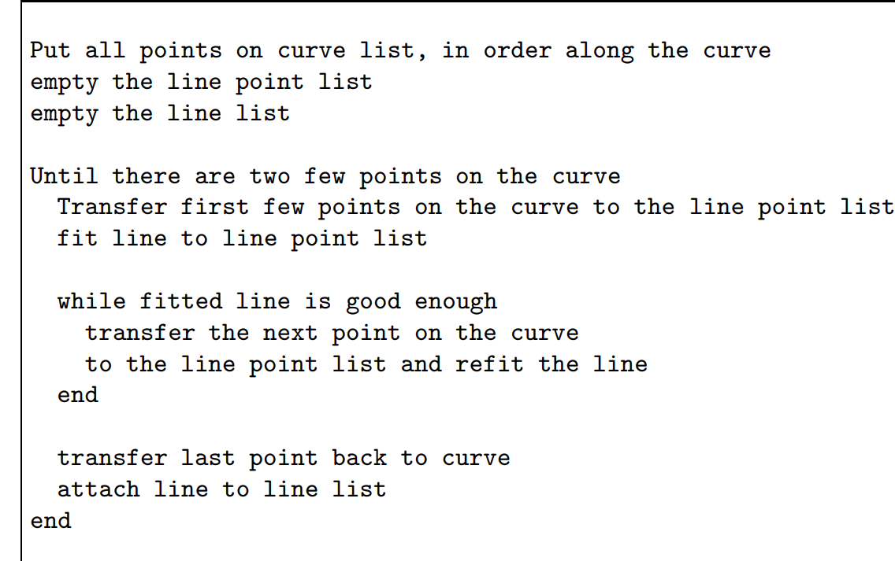

Slide 20
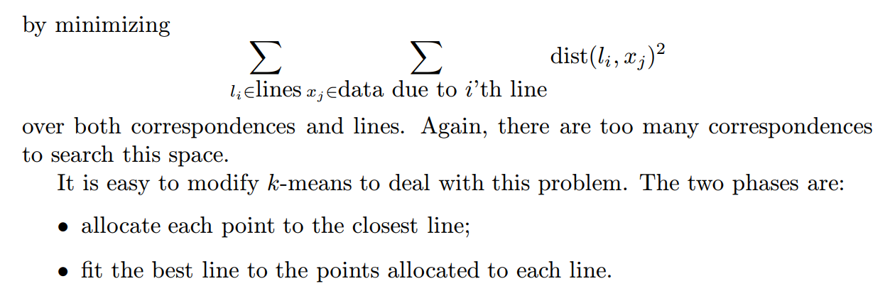
Allocating points to lines with K-means

Slide 21
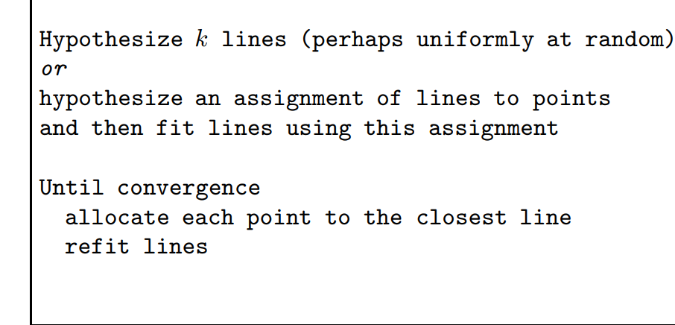

Slide 22
Fitting Lines
Tokens may cluster for other reasons than they are close or have similar colour. One reason to cluster tokens is that, together, they form a familiar geometric configuration — for example, they all lie on a line or on a circle. Clustering tokens into structures is often called fitting.
Line fitting, in particular, is extremely useful. In many applications, objects are characterised by the presence of straight lines.

Slide 23
For example, we might wish to build models of buildings using pictures of the buildings.
This application uses polyhedral models of
buildings, meaning that straight lines in the image are important. Similarly, many industrial parts have straight edges of one form or another, and if we wish to recognise industrial parts in an image, straight lines could be helpful. In either case, a report of all straight lines in the image is an extremely useful segmentation

Slide 24
There are three problems in line fitting. Firstly, given the points that belong to a line, what is the line? Secondly, which points belong to which line? Finally, how many lines are there. We describe the Hough transform, is a method that promises a solution to all three,

Slide 25
Fitting Curves
In principle, fitting curves is not very different from fitting lines. We minimize the sum of squared distances between the points and the curve. This generates quite difficult practical problems: it is usually very hard to tell the distance between a point and a curve.

Slide 26
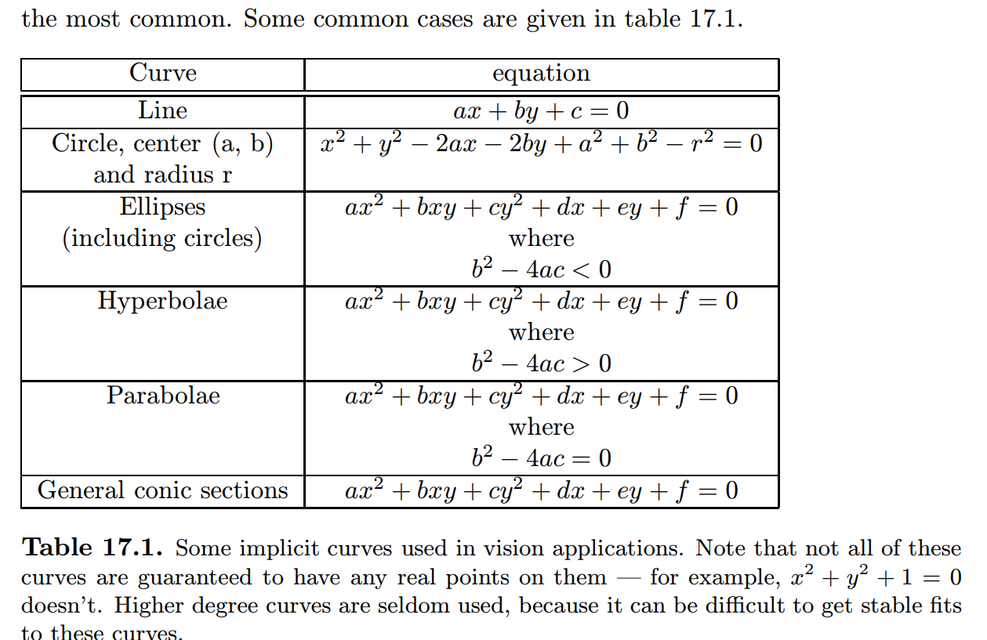
Implicit Curve The coordinates of implicit curves satisfy some parametric equation; if this equation is a polynomial, then the curve is said to be algebraic, and this case is by f s

Slide 27
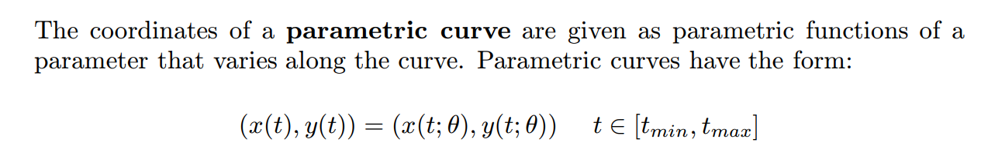
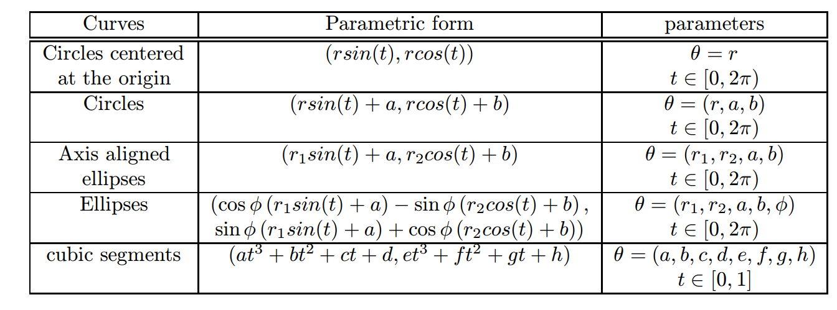

Slide 28
Fitting as a Probabilistic Inference Problem
Up to this point, our criteria for fitting to a model have been arbitrary.
Total least squares seems like a reasonable criterion, but (of course!) the criterion should depend on the kind of error model that we expect — how did the tokens come to not lie on a line in the first place? We return to the problem of fitting a line to a set of points that are known to have come from the line. It turns out that total least squares is, quite naturally, a probabilistic criterion. We start with a model that indicates how image measurements arise

Slide 29
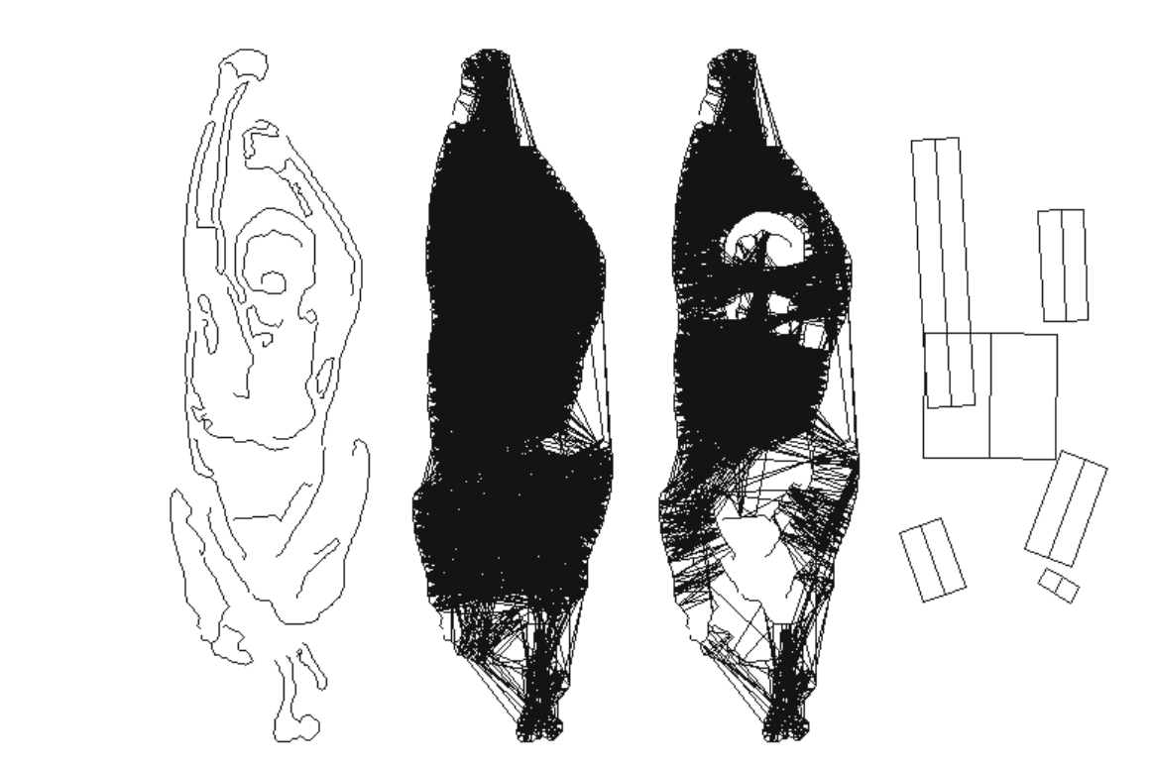

Slide 30
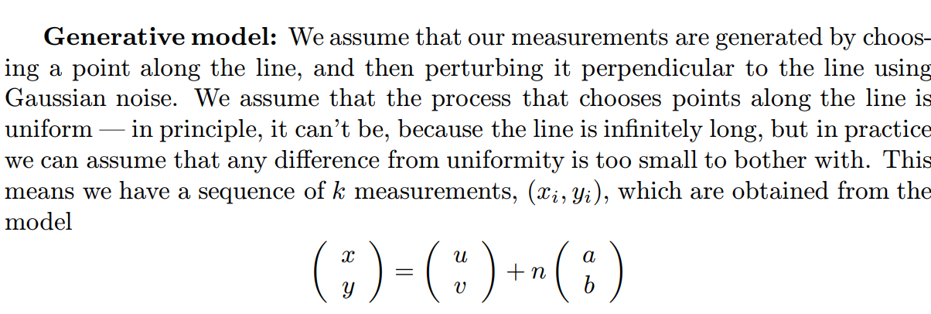
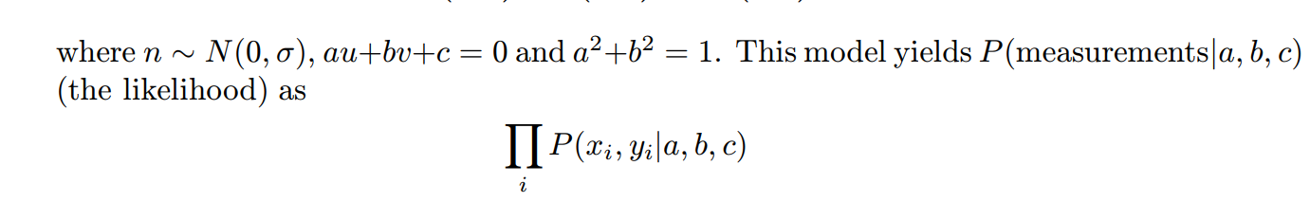

Slide 31
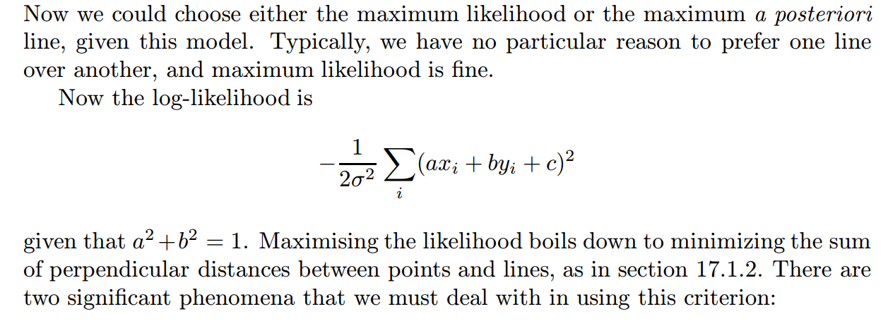

Slide 32
Robustness: the total least squares criterion places huge weight on large errors. This could become a serious problem; for example, if one data point lay a long way from a line that fits all others well (we discuss some mechanisms by which this can happen below), the resulting fitted line will be heavily biased by that data point.
This phenomenon can become a very serious problem. For example, if we are fitting a fundamental matrix to a data set, we need correspondences between data points in left and right images; but if we get one correspondence wrong, we have a potentially huge error in our data set. We discuss this difficulty in detail in the following two sections.

Slide 33
Missing data: we assumed that we knew which points belonged to the line; it is usually the case that we do not. For example, we might have a set of measured points, some of which come from a line and others of which are noise. If we knew which points came from a line, it would be easy to determine what the line was. Similarly, if we knew what line generated the points, it would be easy to determine which points had come from the line. The missing data — which point is noise and which is not — is a crucial component of the problem.

Slide 34
Robustness,
.
It appears to be very difficult to avoid such data points — usually called outliers — in practice. Errors in collecting or transcribing data points is one important source of outliers. Another common source is a problem with the model — perhaps some rare but important effect has been ignored, or the magnitude of an effect has been badly underestimated. Finally, errors in correspondence are particularly prone to generating outliers. Practical vision problems usually involve outliers.

Slide 35
One approach to this problem puts the model at fault: the model predicts these outliers occuring perhaps once in the lifetime in the universe, and they clearly occur much more often than that.
The natural response is to improve the model, either by giving the noise “heavier tails” (section 17.5.1) or by allowing an explicit outlier model. The second strategy requires a study of missing data problems — we don’t know which point is an outlier and which isn’t — and we defer discussion until section 18.2.4 in the following chapter. An alternative approach is to search for points that appear to be good (section 17.5.2)

Slide 36
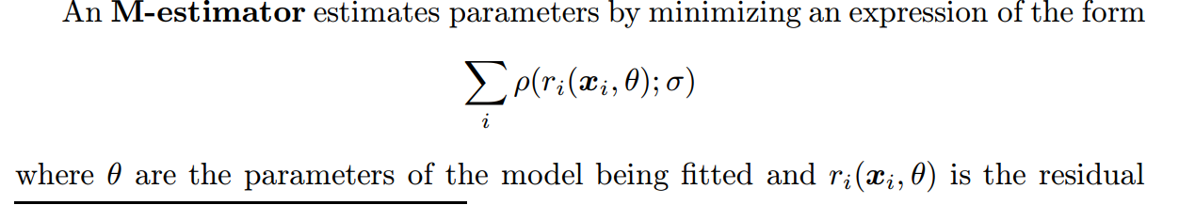

Slide 37
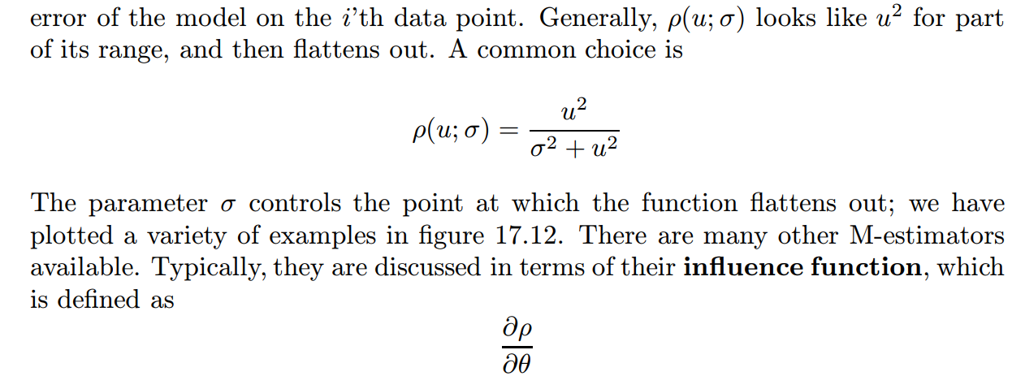

Slide 38
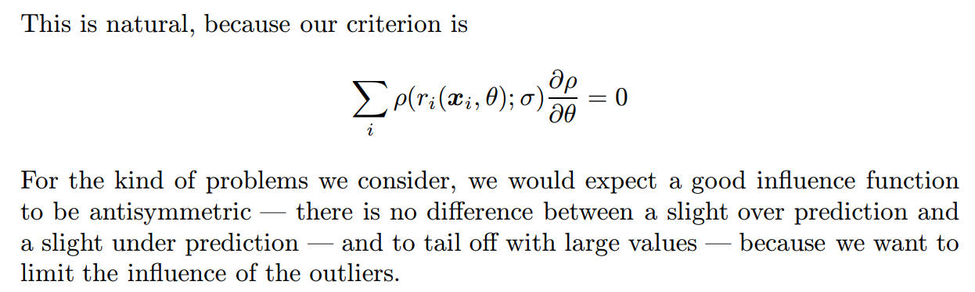

Slide 39
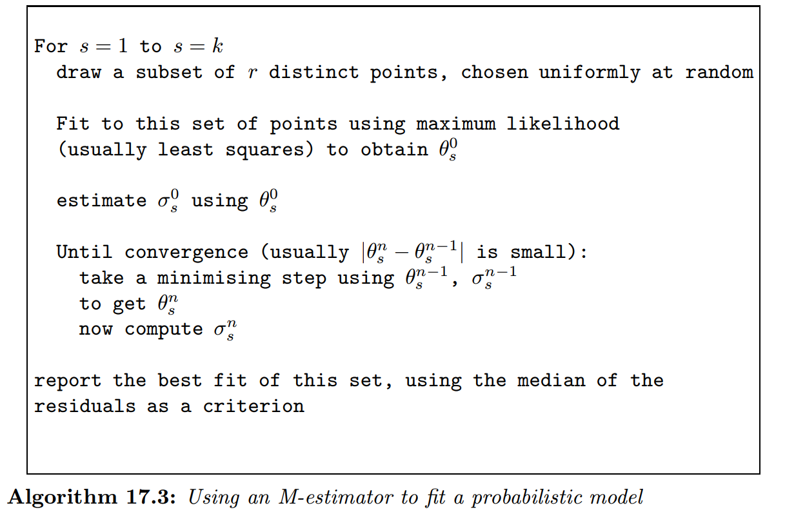

Slide 40
Segmentation and Fitting Using Probabilistic Methods:
All the segmentation algorithms we described in the previous chapter involve essentially local models of similarity. Even though some algorithms attempt to build clusters that are good globally, the underlying model of similarity compares individual pixels. Furthermore, none of these algorithms involved an explicit probabilistic model of how measurements differed from the underlying abstraction that we are seeking

Slide 41
A number of important vision problems can be phrased as missing data problems. For example, we can think of segmentation as the problem of determining from which of a number of sources a measurement came. This is a very general view: segmenting an image into regions involves determining which source of colour and texture pixels generated the image pixels; segmenting a set of tokens into collinear groups involves determining which tokens lie on which line; segmenting a motion sequence into moving regions involves allocating moving pixels to motion models. There is a standard, quite simple, algorithm for this class of problem.

Slide 42
Missing Data Problems
There are two natural contexts in which missing data are important: in the first, some terms in a data vector are missing for some instances and present for other (perhaps someone responding to a survey was embarrassed by a question); in the second, which is far more common in our applications, an inference problem can be made very much simpler by rewriting it using some variables whose values are unknown. We will demonstrate this method and appropriate algorithms with two examples

Slide 43
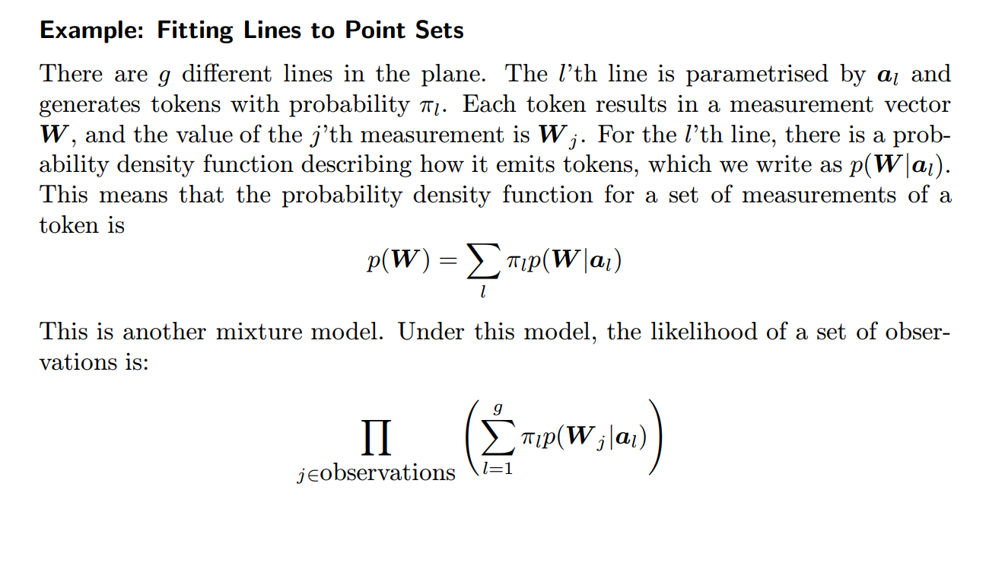

Slide 44
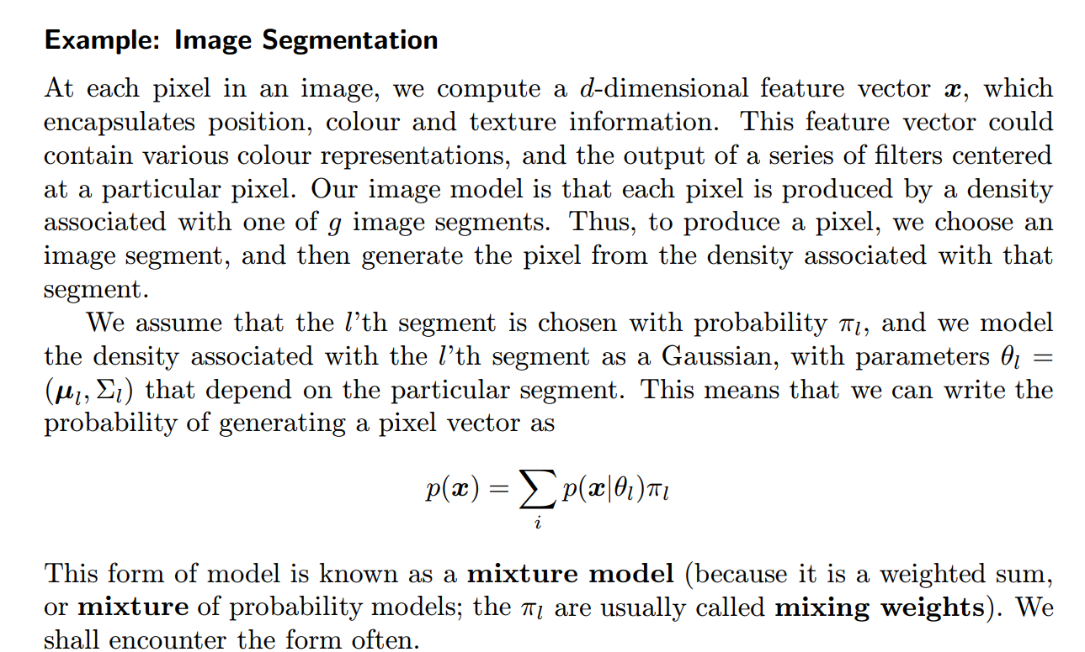
Fitting, and Segmentation,

Slide 45
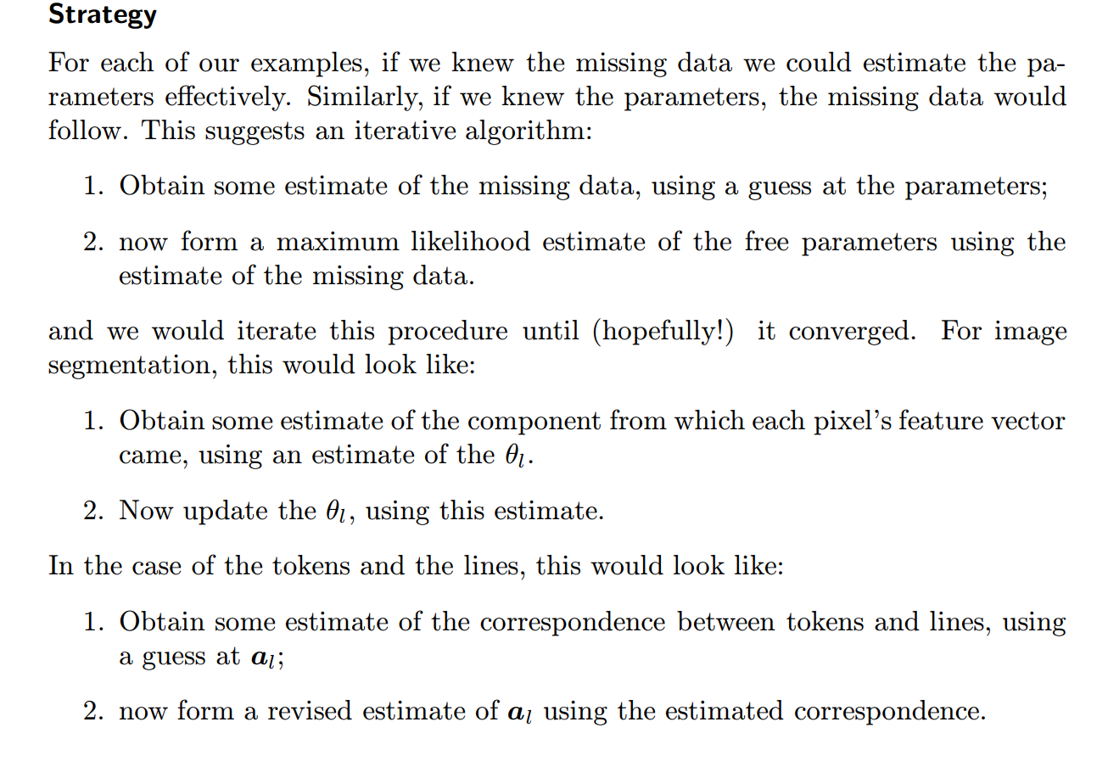

Slide 46
The EM Algorithm in Practice
Although it would be nice if the procedures given above converged, there is no particular reason to believe that they do. In fact, given appropriate choices in each stage, they do. This is most easily shown by showing that they are examples of a general algorithm, the expectation-maximization algorithm.

Slide 47
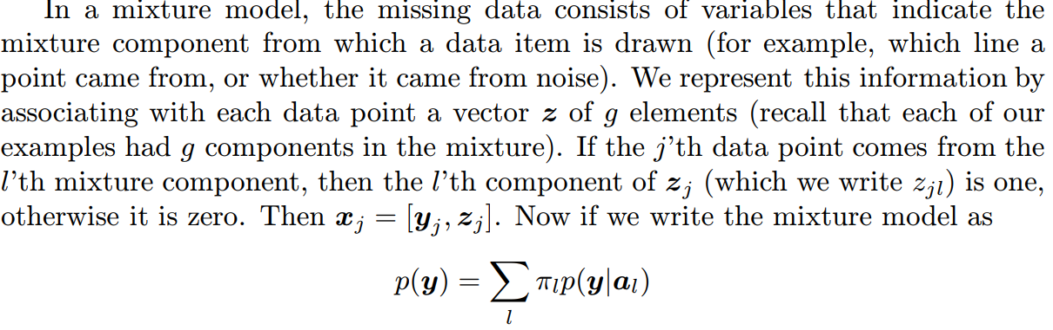

Slide 48
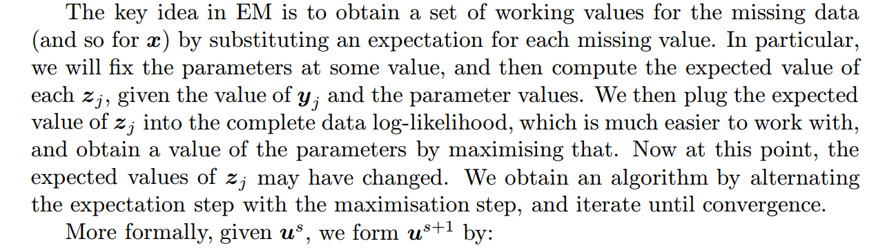

Slide 49
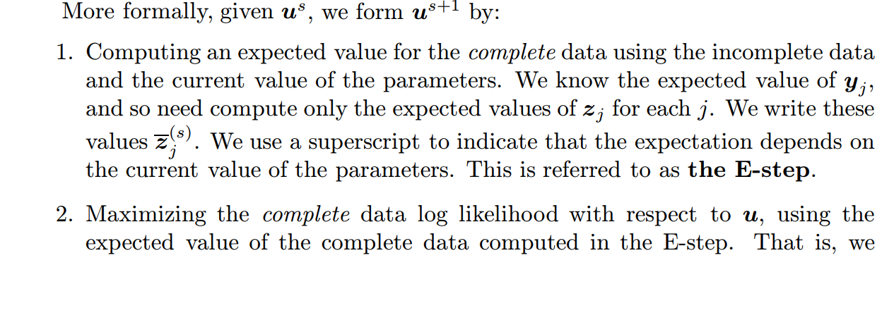
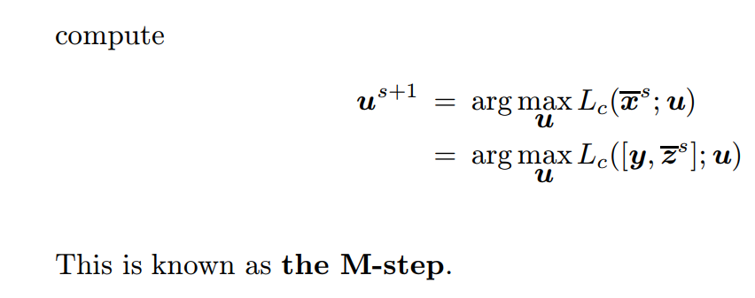

Slide 50
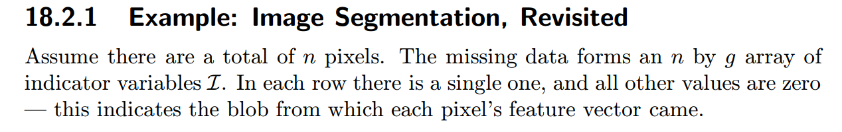
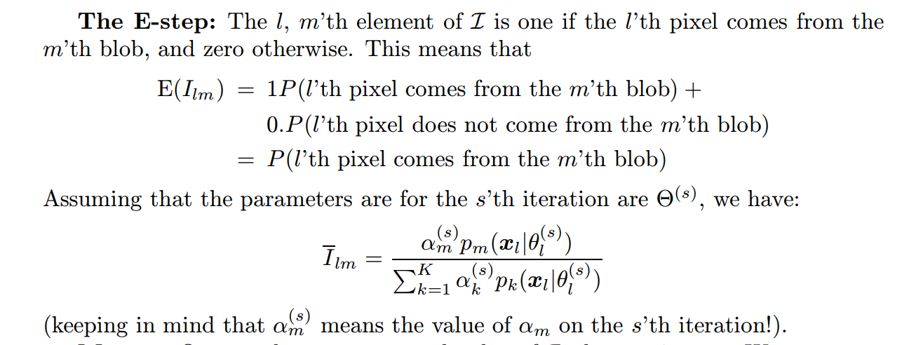

Slide 51
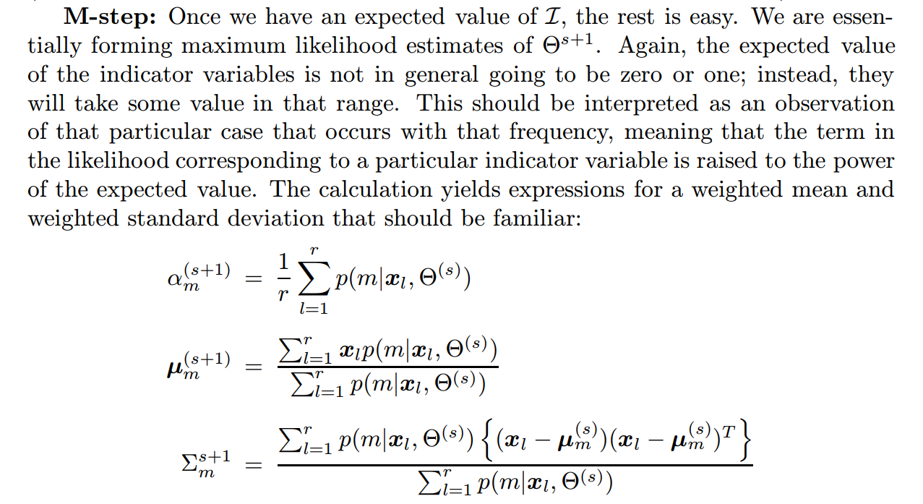

Slide 52
Example: Line Fitting with EM
An EM line fitting algorithm follows the lines of the example above; the missing data is an array of indicator variables M whose k, l’th element mkl is one if point

Slide 53
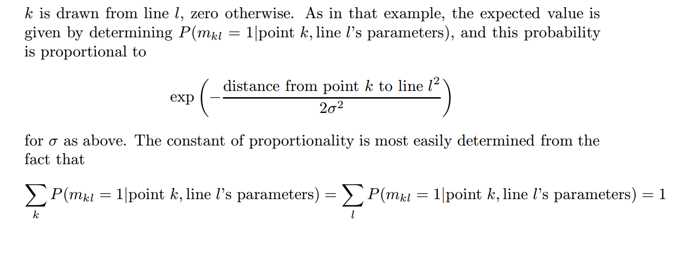

Slide 54
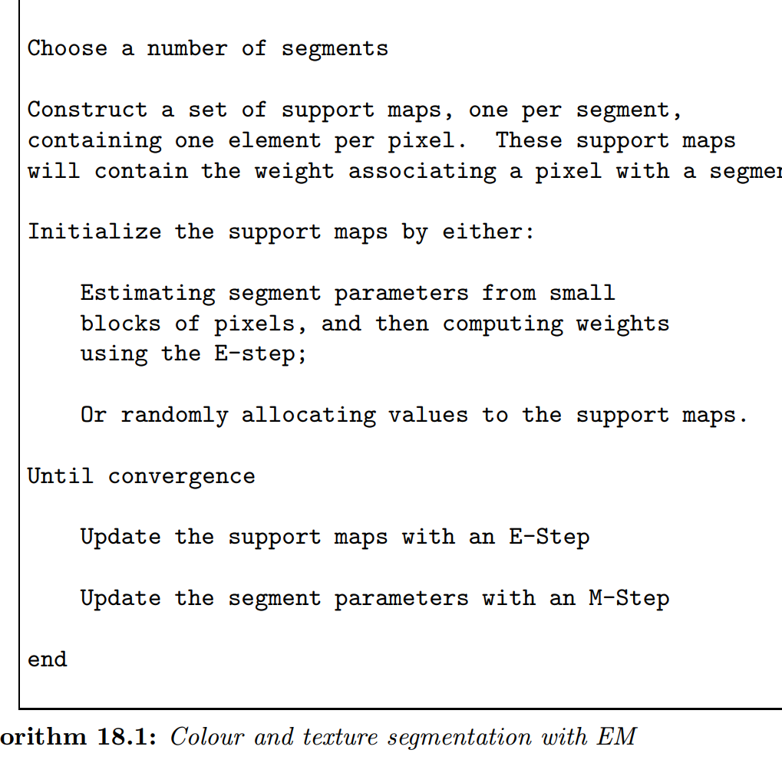

Slide 55
Tracking With Linear Dynamic Models:
Tracking is the problem of generating an inference about the motion of an object given a sequence of images. Good solutions to this problem have a variety of applications:

Slide 56
Motion Capture: if we can track a moving person accurately, then we can make an accurate record of their motions. Once we have this record, we can use it to drive a rendering process; for example, we might control a cartoon character, thousands of virtual extras in a crowd scene, or a virtual stunt avatar. Furthermore, we could modify the motion record to obtain slightly different motions. This means that a single performer can produce sequences they wouldn’t want to do in person.

Slide 57
Recognition From Motion: the motion of objects is quite characteristic. We may be able to determine the identity of the object from its motion; we should be able to tell what it’s doing. • Surveillance: knowing what objects are doing can be very useful. For example, different kinds of trucks should move in different, fixed patterns in an airport; if they do not, then something is going very wrong. Similarly, there are combinations of places and patterns of motions that should never occur (no truck should ever stop on an active runway, say). It could be helpful to have a computer system that can monitor activities and give a warning if it detects a problem case.

Slide 58
Targeting: a significant fraction of the tracking literature is oriented towards (a) deciding what to shoot and (b) hitting it. Typically, this literature describes tracking using radar or infra-red signals (rather than vision), but the basic issues are the same — what do we infer about an object’s future position from a sequence of measurements? (i.e. where should we aim?

Slide 59
Tracking is properly thought of as an inference problem. The moving object has some form of internal state, which is measured at each frame. We need to combine our measurements as effectively as possible to estimate the object’s state. There are two important cases. Either both dynamics and measurement are linear in which case, the inference problem is straightforward, and has a standard solution. If we are faced with non-linear dynamics, even very slight non-linearities in system dynamics have tremendous effects.

Slide 60
Tracking as an Abstract Inference Problem
We model the object as having some internal state; the state of the object at the i’th frame is typically written as Xi. The capital letters indicate that this is a random variable — when we want to talk about a particular value that this variable takes, we will use small letters. The measurements obtained in the i’th frame are values of a random variable Y i; we shall write yi for the value of a measurement, and, on occasion, we shall write Y i = yi for emphasis. There are three main problems

Slide 61
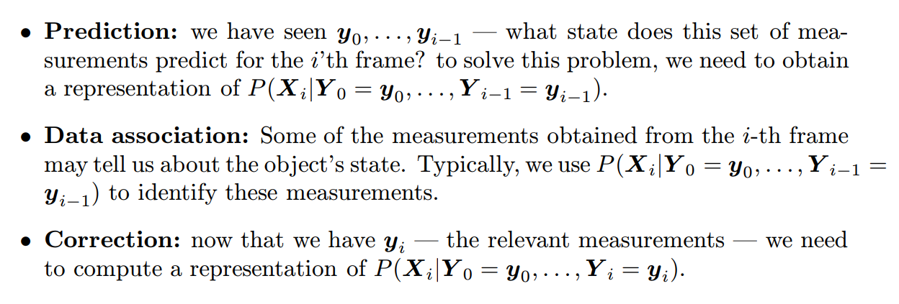

Slide 62
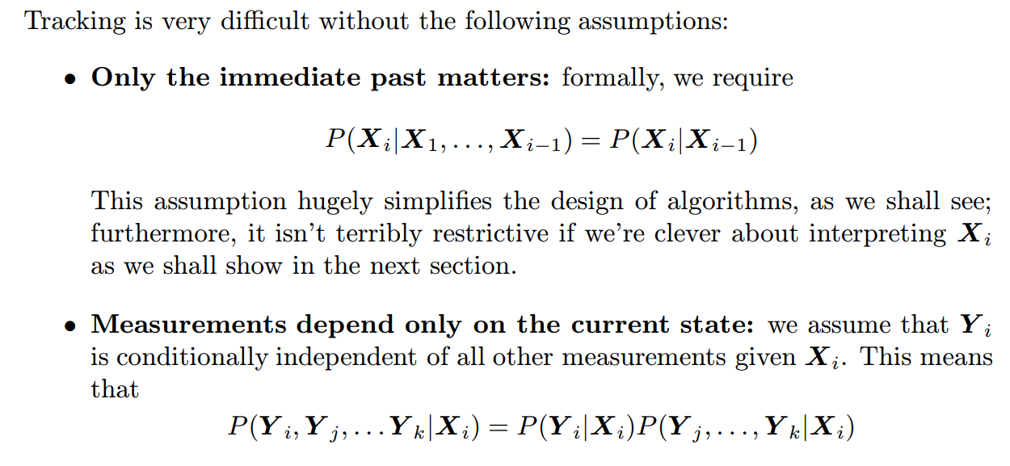
Independence Assumptions

Slide 63
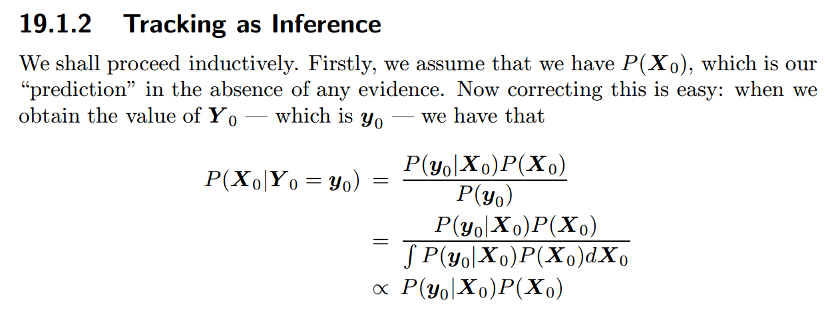

Slide 64
Linear Dynamic Models,
There are good relations between linear transformations and Gaussian probability densities.
The practical consequence is that, if we restrict attention to linear dynamic models and linear measurement models, both with additive Gaussian noise, all the densities we are interested in will be Gaussians.

Slide 65
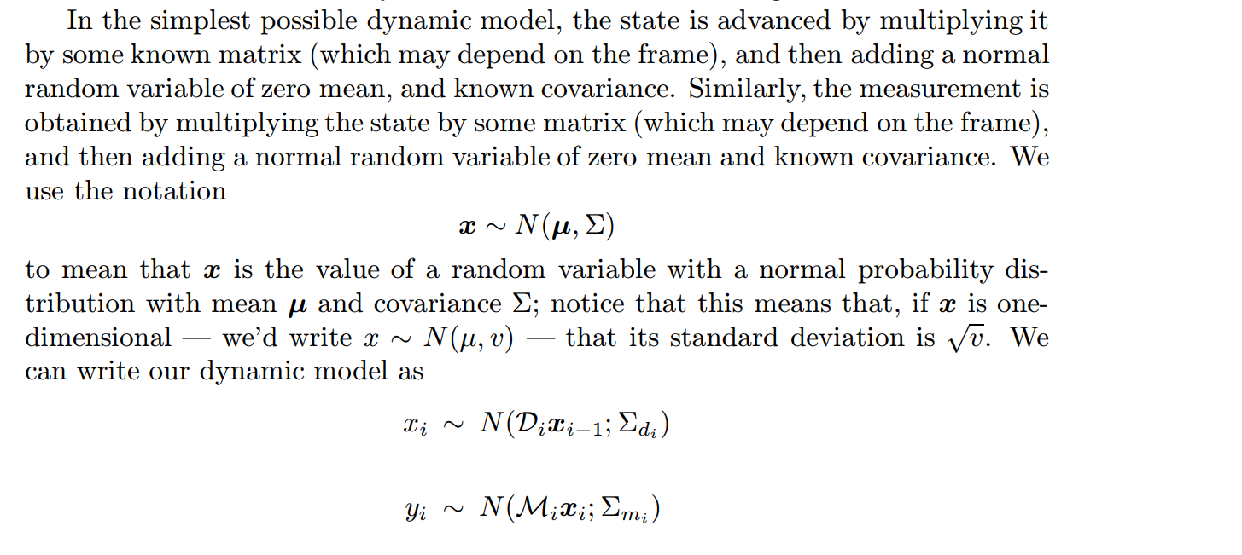

Slide 66
Kalman Filtering
An important feature of linear dynamic models is that all the conditional probability models we need to deal with are normal. In particular, P(Xi|y1,..., yi−1) is normal;
as is P(Xi|y1,..., yi). This means that they are relatively easy to represent — all we need to do is maintain representations of the mean and the covariance for the prediction and correction phase. In particular, our model will admit a relatively simple process where the representation of the mean and covariance for the prediction and estimation phase are updated.

Slide 67
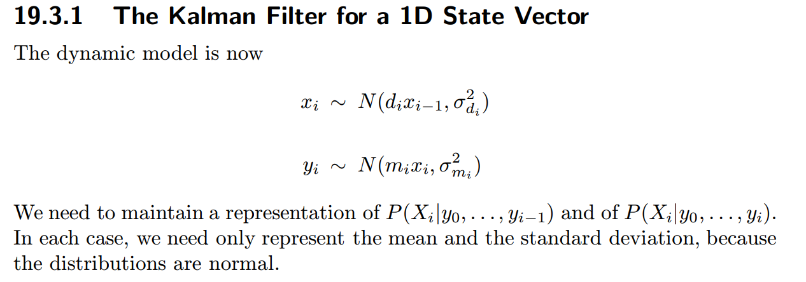

Slide 68
Data Association

Slide 69
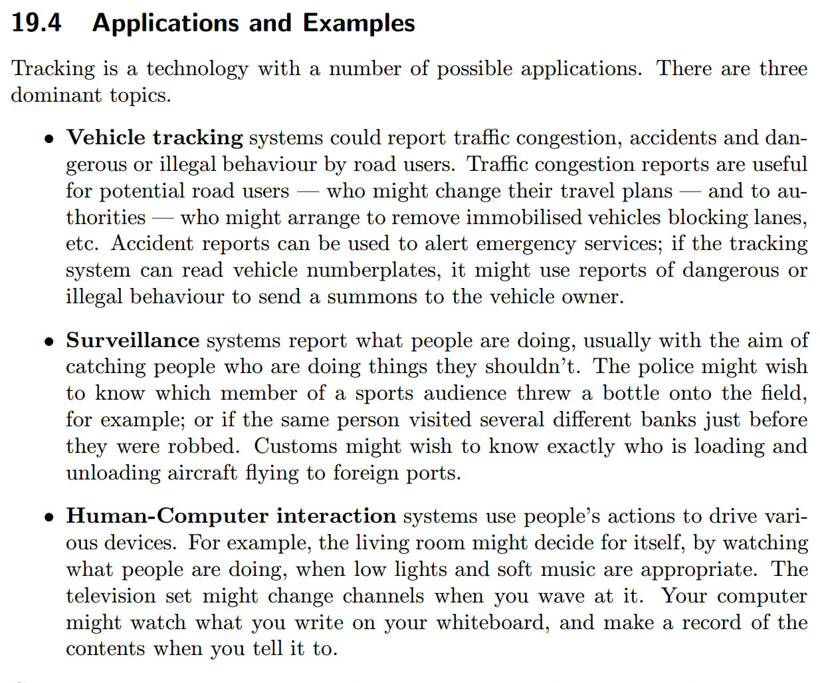
Applications and Examples

